Slide 1
CREATING A SYSTEM WHICH CONTROLS AND MONITORS A DEVICE REMOTELY Using Dragino Yun and Temboo

Slide 2
MEMBERS
NAME
STUDENT ID
SADMAN ARAF
SAJID HOSSAIN
SHAIMA KHANDOKER
SAYED US SADAT
17101354
17101352
17101003
17101364

Slide 3
01
INTRODUCTION
03
04

Slide 4
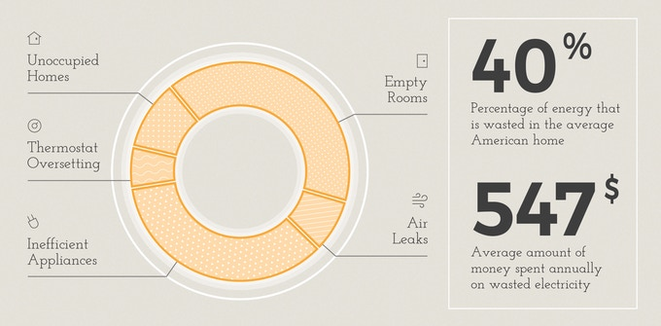
SAVE ENERGY, SAVE MONEY!

Slide 5
02
OUR CONTRIBUTIONS
03
04

Slide 6

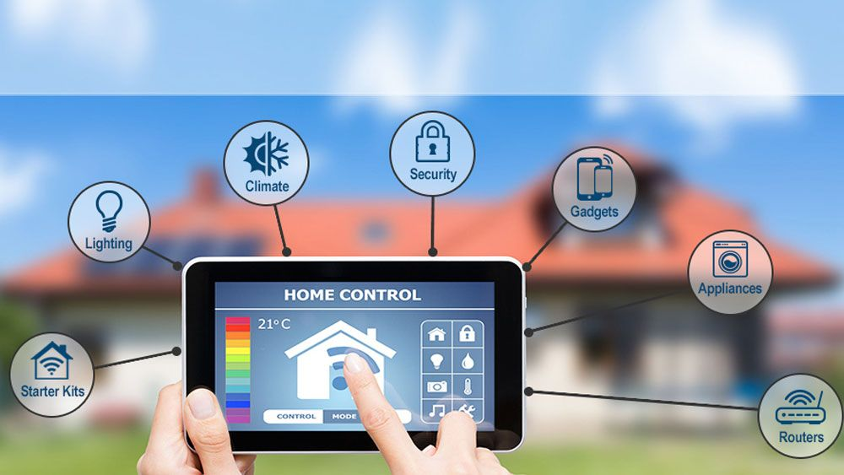
TECHNOLOGY
IOT Home Automation

Slide 7
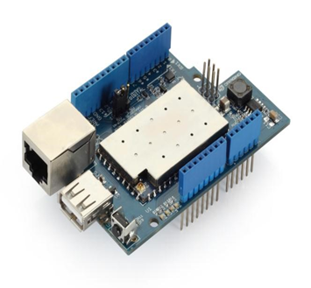
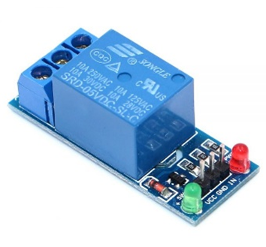
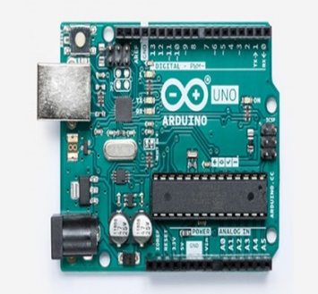
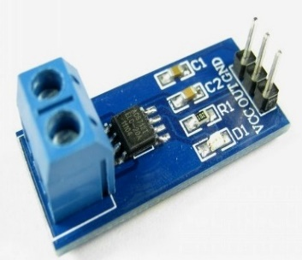
OUR COMPONENTS AND CONTRIBUTION
01
Monitor Energy Consumption
02
Remotely Turn On/Off Devices Via
Internet
SINGLE CHANNEL 5V
RELAY MODULE
DRAGINO YUN SHEILD
Creating A Sophisticated Website
Control Device
03
Current Data Can Be Used For
Research Purpose
04
ARDUINO UNO
ANALOG CURRENT SENSOR

Slide 8
03
PROPOSED SYSTEM
03
04

Slide 9
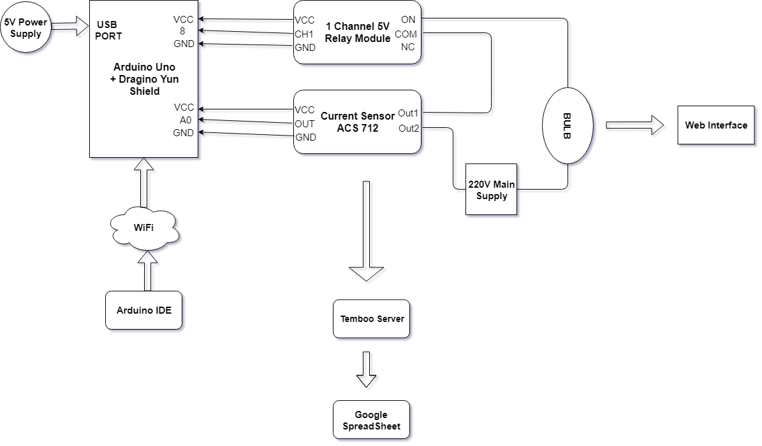
PROPOSED SYSTEM
The Pin Connections to the System
Arduino Uno and Dragino Yun Shield
Relay
VCC → VCC pin
Pin8 → CH1 pin
GND → GND pin
Current Sensor
VCC → VCC pin
A0 Pin → Output pin
GND → GND pin
The AVR board is connected to the 5V supply to power the system and is sending and receiving data via Wi-Fi.
Circuit

Slide 10
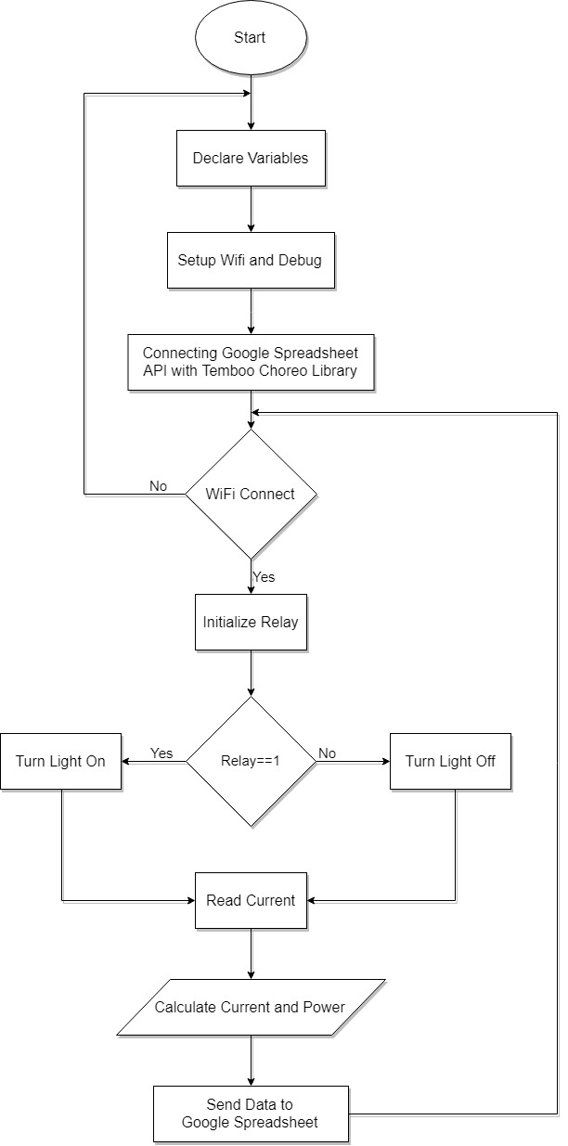
FLOW CHART
04

Slide 11
04
RELATED WORKS
03
04

Slide 12
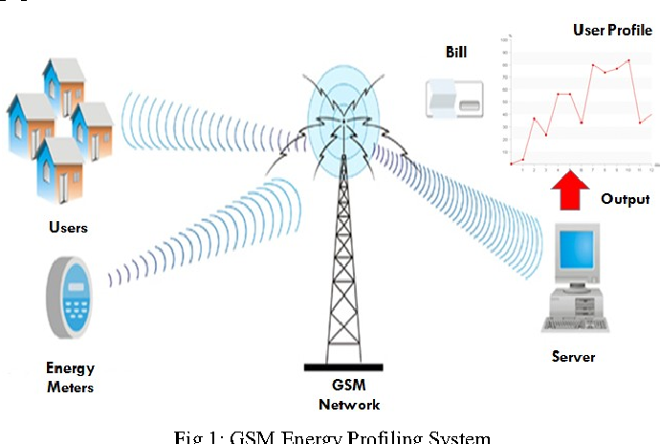
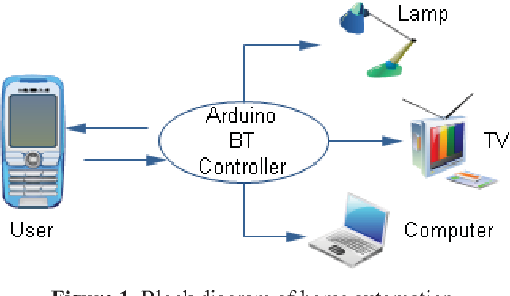
RELATED WORKS
Remote Energy Monitoring, Profiling and Controlling through GSM Network
Bluetooth Based Home Automation System Using Cellphone

Slide 13
05
CHALLENGES
03
04

Slide 14
CHALLENGES
01
Designing And Building The Structure
02
Needs A Strong WIFI Network
03
Coding Complicacies
04
Security Factor

Slide 15
06
COMPETITIONS
03
04

Slide 16
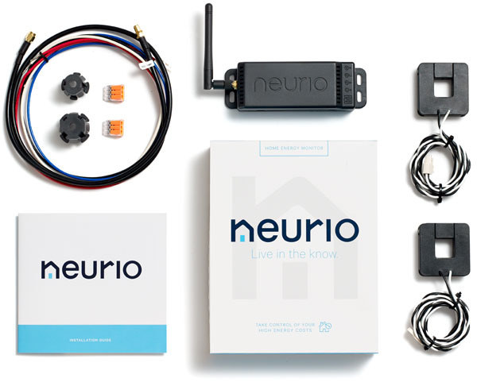
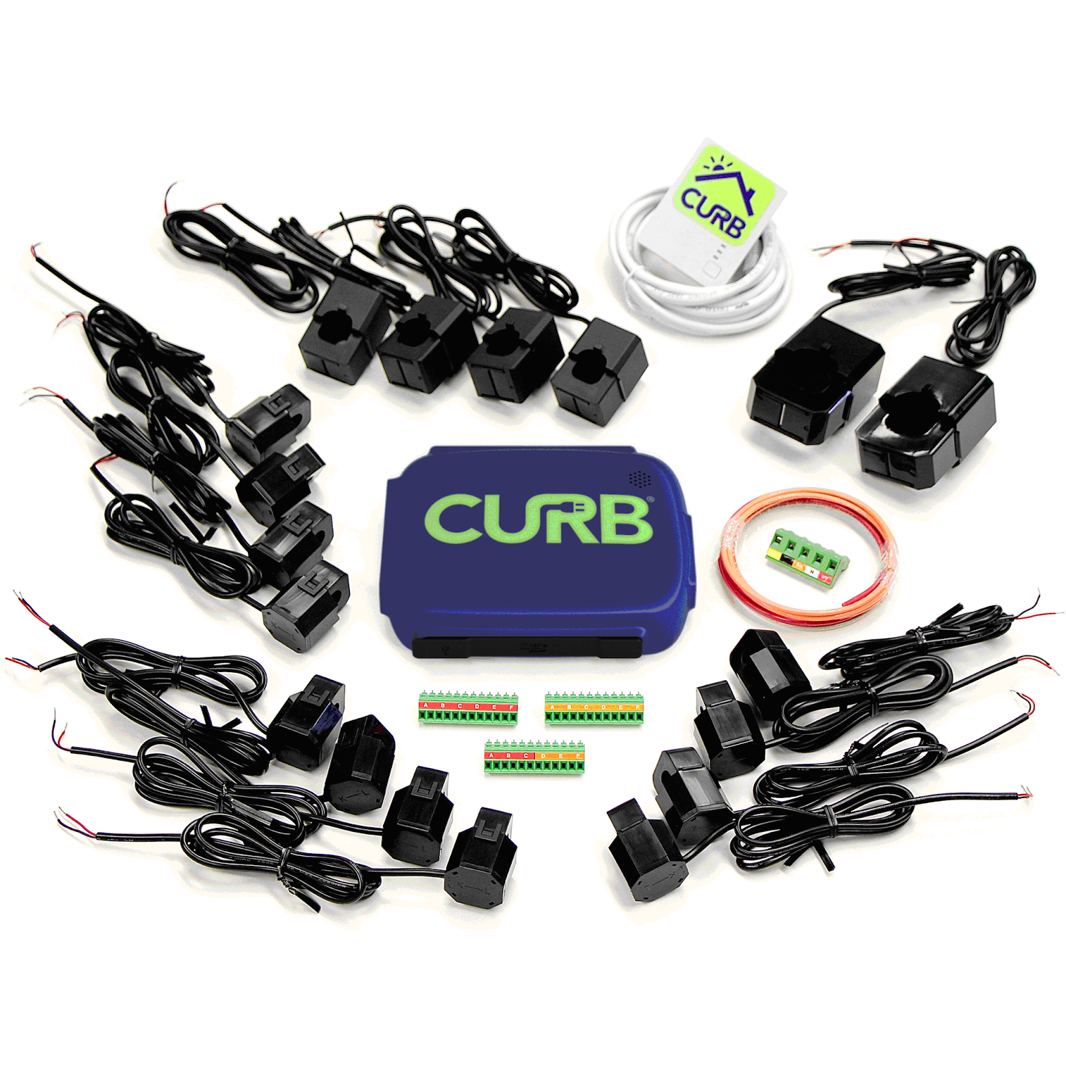
COMPETITIONS
Neurio Energy Monitor
A continuous view on how your home's power is being utilized, shown on your web application
CURB
Real-time information on your energy utilization & approximate your energy bill, enabling you to see the effect of your energy

Slide 17
07
CONCLUSION
03
04

Slide 18
CONCLUSION
IMPROVEMENTS
Control of the device
Further extension
01
We can also extend the control of devices from a longer distance
03
From simple web interface we can also build a mobile app to control the devices.
Security
02
04
Accuracy
Extra Security features like login, app passwords can also be added
Advanced current senors can also be used to improve accuracy.

Slide 19
THANK YOU

